Slide 1

Airline Fatalities
Harlan Wittlieff
Data Science, Bellevue University
DSC 640: Data Presentation & Visualization
Catherine Williams
April 23, 2022

Slide 2
Overview
Media focus on airline safety with messaging that air is no longer a safe way to travel
Data analysis results:
Airplane accident trends
Airline travel vs automobile travel
How our airline compares

Slide 3
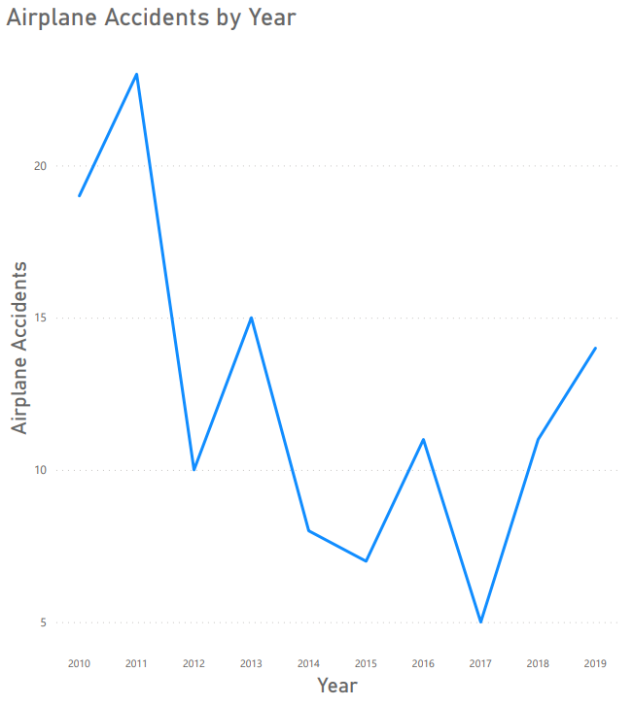
Airplane Accident Trends
Over the past decade accidents have seen a downward trend
An uptick over the past two years may be causing the additional media scrutiny

Slide 4
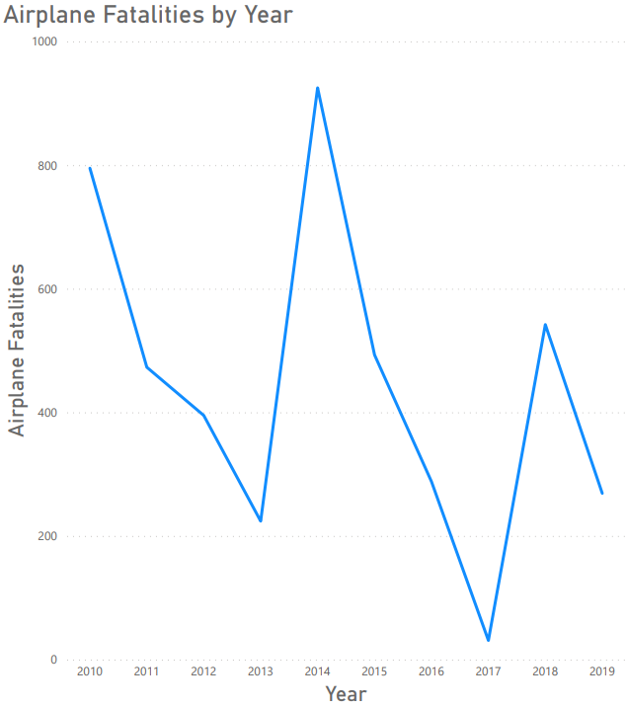
Airplane Accident Trends
Year to year fatalities have some variability
Overall, over the past decade, fatalities have decreased

Slide 5
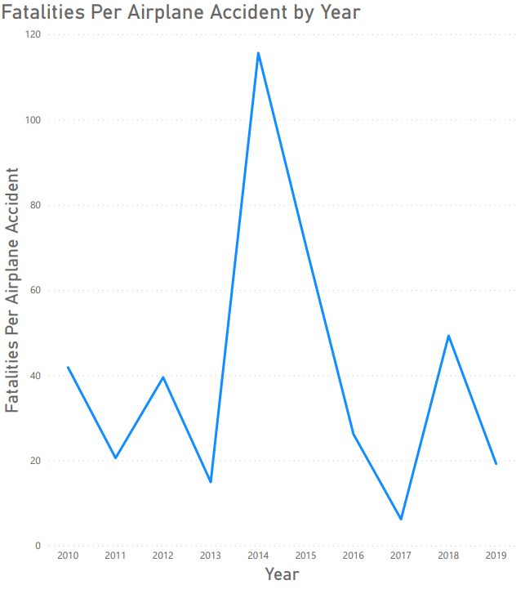
Airplane Accident Trends
2014 and 2015 saw more deadly individual accidents
Except for 2014 and 2015, fatalities per accident has remained constant over the past decade

Slide 6
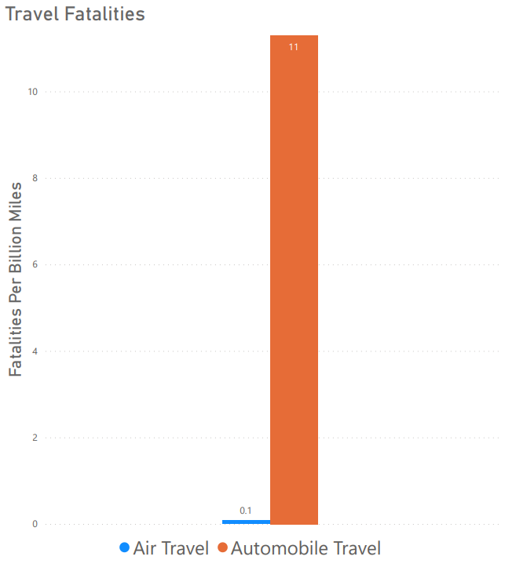
Airline travel remains a safe choice
Airline travel is still the safer way to travel when compared to automobiles

Slide 7
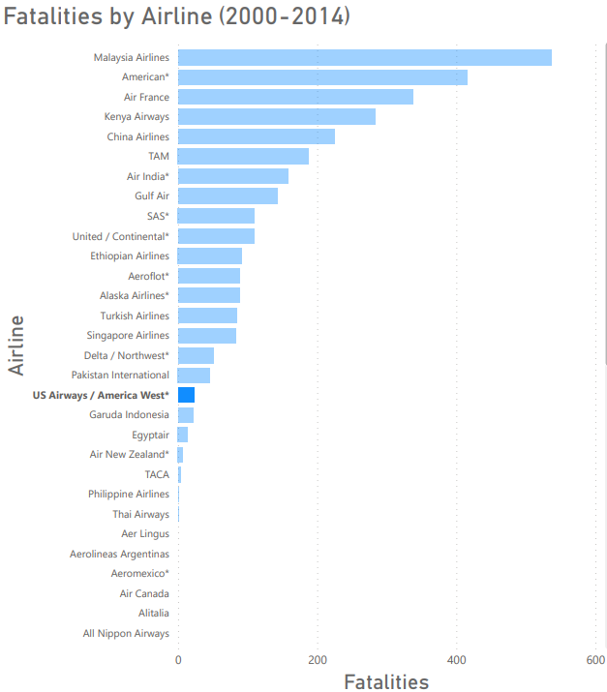
Where do we fit in?
We at US Airways see fewer total fatalities compared to our competition

Slide 8
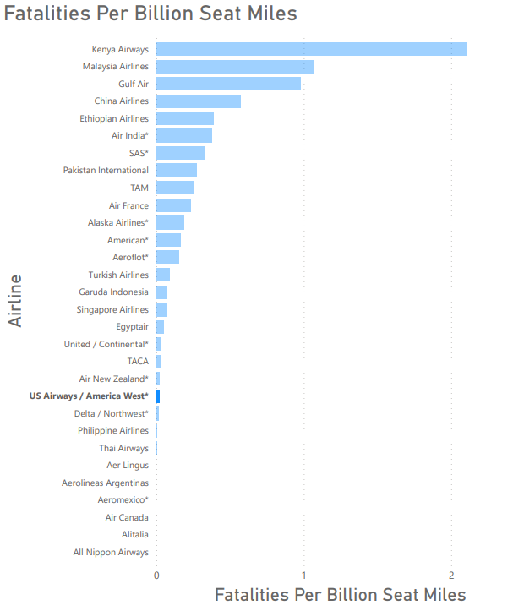
Where do we fit in?
We also see fewer fatalities per billion seat miles when compared against our competition

Slide 9
Concluding Remarks
Recent uptick in airline accidents may be causing the influx in media attention
US Airways had significantly fewer fatalities compared to competitors

